Slide 1
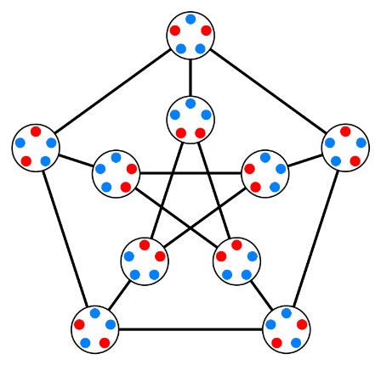
Principle of Inclusion – Exclusion

Slide 2
Recap
Permutations
Combinations

Slide 3
Try to solve this one? You have one minute to answer
Counting Bit Strings
How many bit strings of length eight either start with a 1 bit or end with the two bits 00?

Slide 4
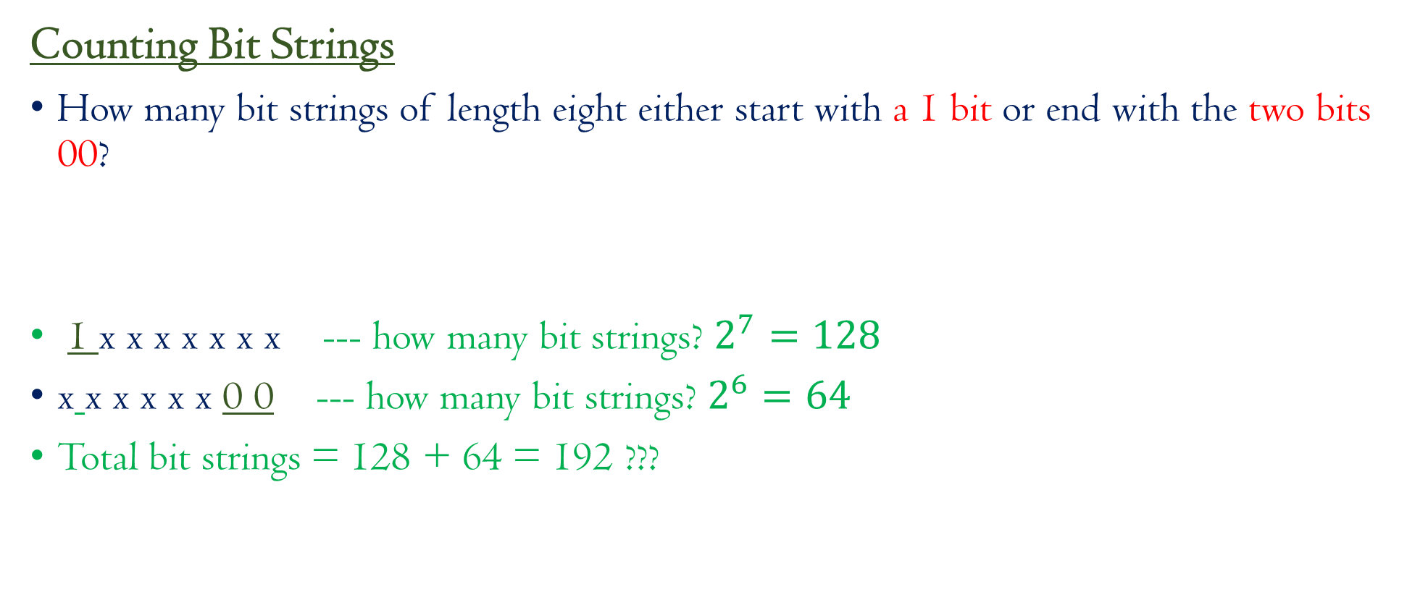
Try to solve this one? You have one minute to answer
Counting Bit Strings
How many bit strings of length eight either start with a 1 bit or end with the two bits 00?
1 x x x x x x x --- how many bit strings? $2^{7}=128$
x x x x x x 0 0 --- how many bit strings? $2^{6}=64$
Total bit strings = 128 + 64 = 192 ???

Slide 5
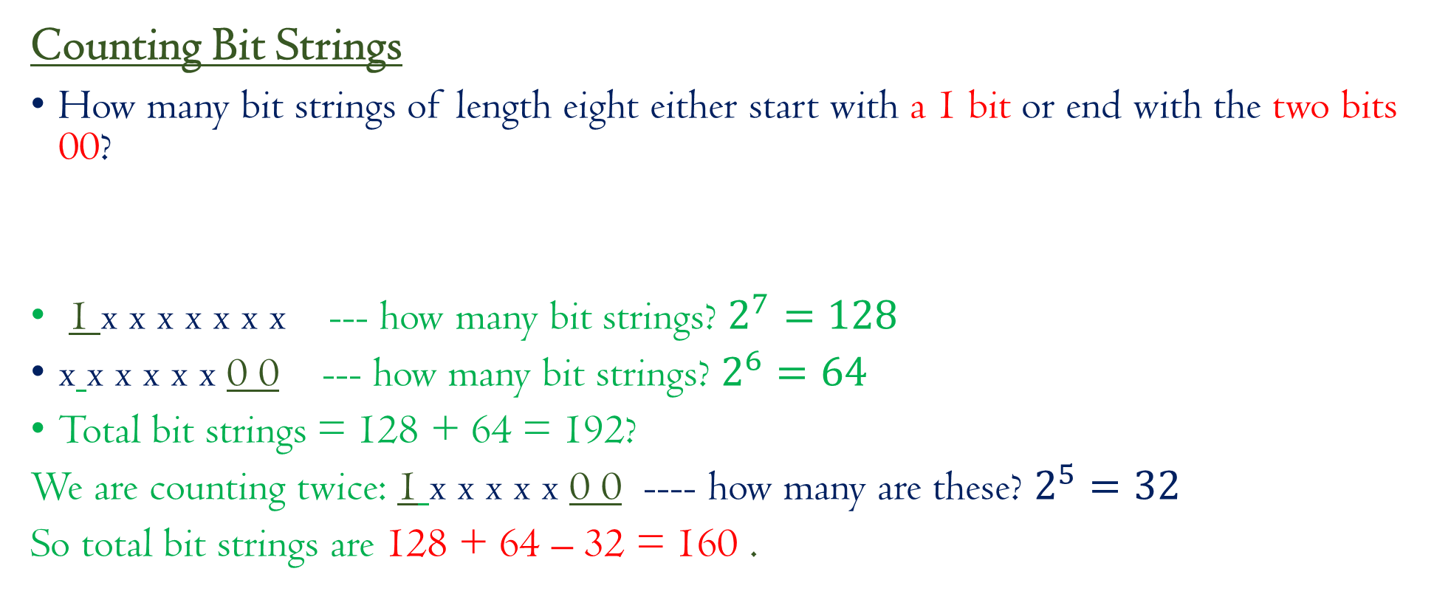
Try to solve this one? You have one minute to answer
Counting Bit Strings
How many bit strings of length eight either start with a 1 bit or end with the two bits 00?
1 x x x x x x x --- how many bit strings? $2^{7}=128$
x x x x x x 0 0 --- how many bit strings? $2^{6}=64$
Total bit strings = 128 + 64 = 192?
We are counting twice: 1 x x x x x 0 0 ---- how many are these? $2^{5}=32$
So total bit strings are 128 + 64 – 32 = 160 .

Slide 6
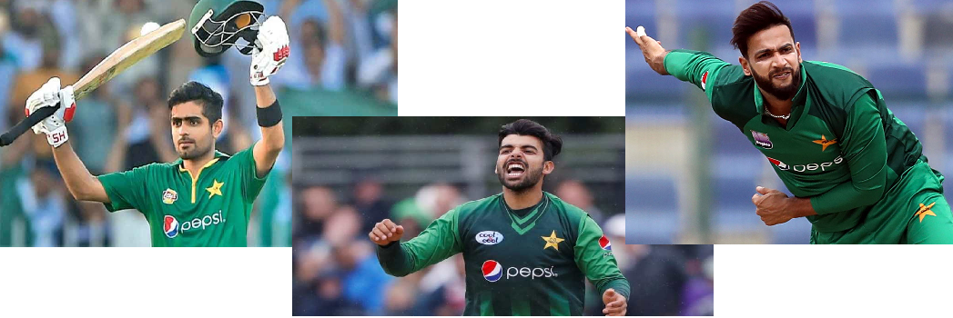
Principle of Inclusion – Exclusion (Section 2.3 of book)
40 students
Babar Azam – 18
Shadab Khan – 16
Emad Wasim – 12

Slide 7
Principle of Inclusion – Exclusion (Section 2.3 of book)
40 students
Babar Azam – 18
Shadab Khan – 16
Emad Wasim – 12
BS = 7
BE = 5
SE = 3
BSE = 2

Slide 8
Principle of Inclusion – Exclusion (Section 2.3 of book)
40 students
Babar Azam – 18
Shadab Khan – 16
Emad Wasim – 12
BS = 7
BE = 5
SE = 3
BSE = 2
Students having pics = 18 + 16 + 12 – 7 – 5 – 3 + 2 = 33
Students not having any pic =

Slide 9
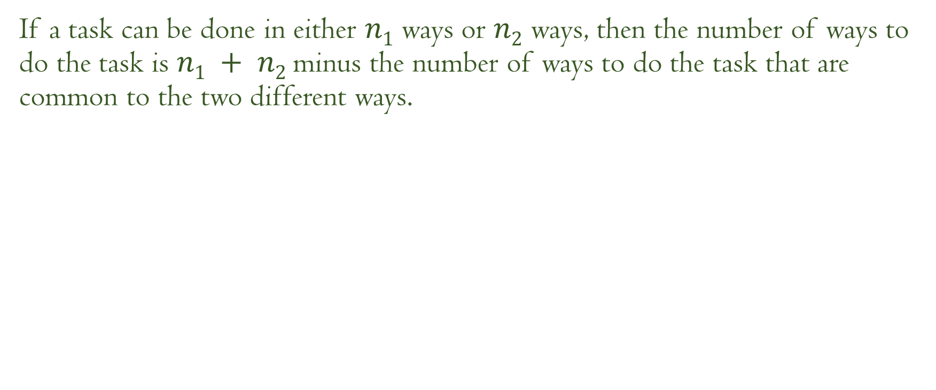
Principle of Inclusion – Exclusion (Section 2.3 of book)
If a task can be done in either $n1$ ways or $n2$ ways, then the number of ways to do the task is $n1 + n2$minus the number of ways to do the task that are common to the two different ways.

Slide 10
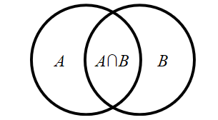
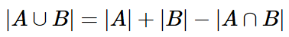
Principle of Inclusion – Exclusion

Slide 11
Try to solve this one? You have one minute to answer
Counting possible passwords
Each user on a computer system has a password, which is six characters long, where each character is an uppercase letter or a digit. Each password must contain at least one digit. How many possible passwords are there?

Slide 12
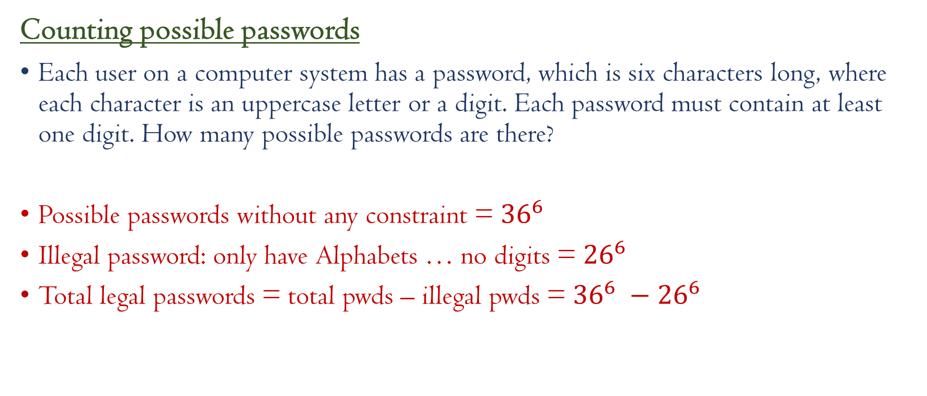
Try to solve this one? You have one minute to answer
Counting possible passwords
Each user on a computer system has a password, which is six characters long, where each character is an uppercase letter or a digit. Each password must contain at least one digit. How many possible passwords are there?
Possible passwords without any constraint = ${36}^{6}$
Illegal password: only have Alphabets … no digits = ${26}^{6}$
Total legal passwords = total pwds – illegal pwds = ${36}^{6} −{26}^{6}$

Slide 13
Problem 1
Examples: PIE --- Do it by yourself
Let A = {1,2,3,4,5} and B = {3,4,5,6,7}.
|A∪B| = ?

Slide 14
Problem 1
Examples: PIE --- Do it by yourself
Let A = {1,2,3,4,5} and B = {3,4,5,6,7}.
|A∪B| = ?
Then A ∪ B = {1,2,3,4,5,6,7}.
By inspection, |A∪B| = 7, but you can also verify that |A∪B| = 7 = 5 + 5−3 = |A|+|B|−|A∩B|.

Slide 15
Problem 2
Examples: PIE --- Do it by yourself
How many positive integers not bigger than 20 are divisible by either 2 or 3?
Numbers divisible by 2 = 20/2 = 10
Numbers divisible by 3 = round(20/3) = 6
Numbes divisible by both 2 and 3 = 20/(2x3) = 3
Total numbers = 10+6 -3 = 13

Slide 16
Problem 3
Examples: PIE --- Do it by yourself

Slide 17
Problem 4
Examples: PIE --- Do it by yourself
How many positive integers up to 1000 are divisible by 7 or 11?
Numbers divisible by 7 = 1000/7 = 142
Numbers divisible by 11 = 1000/11 = 90
Numbers divisible by both 7 and 11 = 1000/(7x11) = 12
Total number = 142 + 90 – 12 = 220

Slide 18
Problem 5
Examples: PIE --- Do it by yourself
How many positive integers up to 1000 are NOT divisible by 7 or 11?
1000 – previous answer = 1000 – 220 = 780.

Slide 19
Problem 6
Examples: PIE --- Do it by yourself
How many bit-strings of length eight either begin with 00 or end with 101?

Slide 20
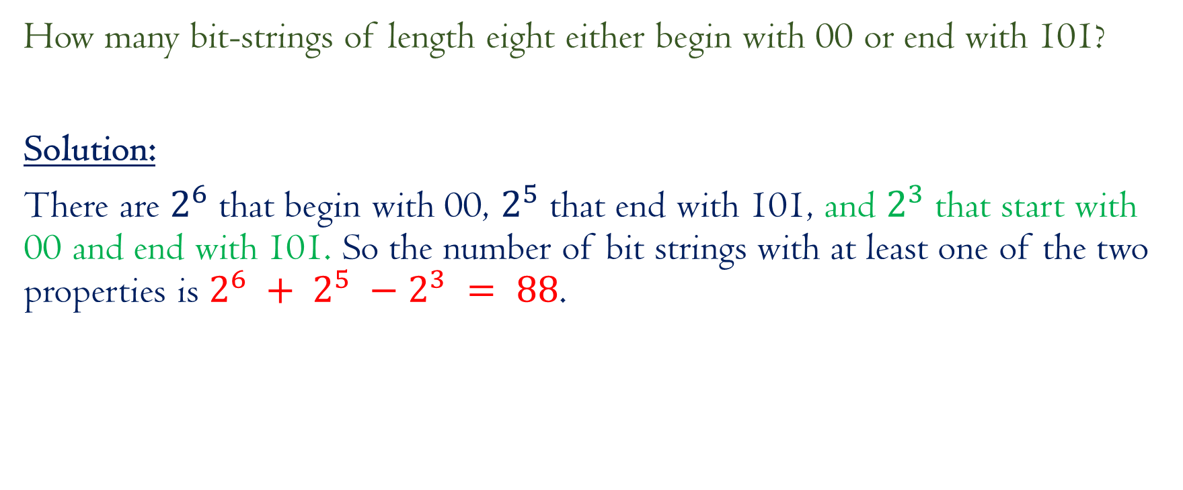
Problem 6
Examples: PIE --- Do it by yourself
How many bit-strings of length eight either begin with 00 or end with 101?
Solution:
There are $2^{6}$ that begin with 00, $2^{5}$ that end with 101, and $2^{3}$ that start with 00 and end with 101. So the number of bit strings with at least one of the two properties is $2^{6} + 2^{5} −2^{3} = 88$.

Slide 21
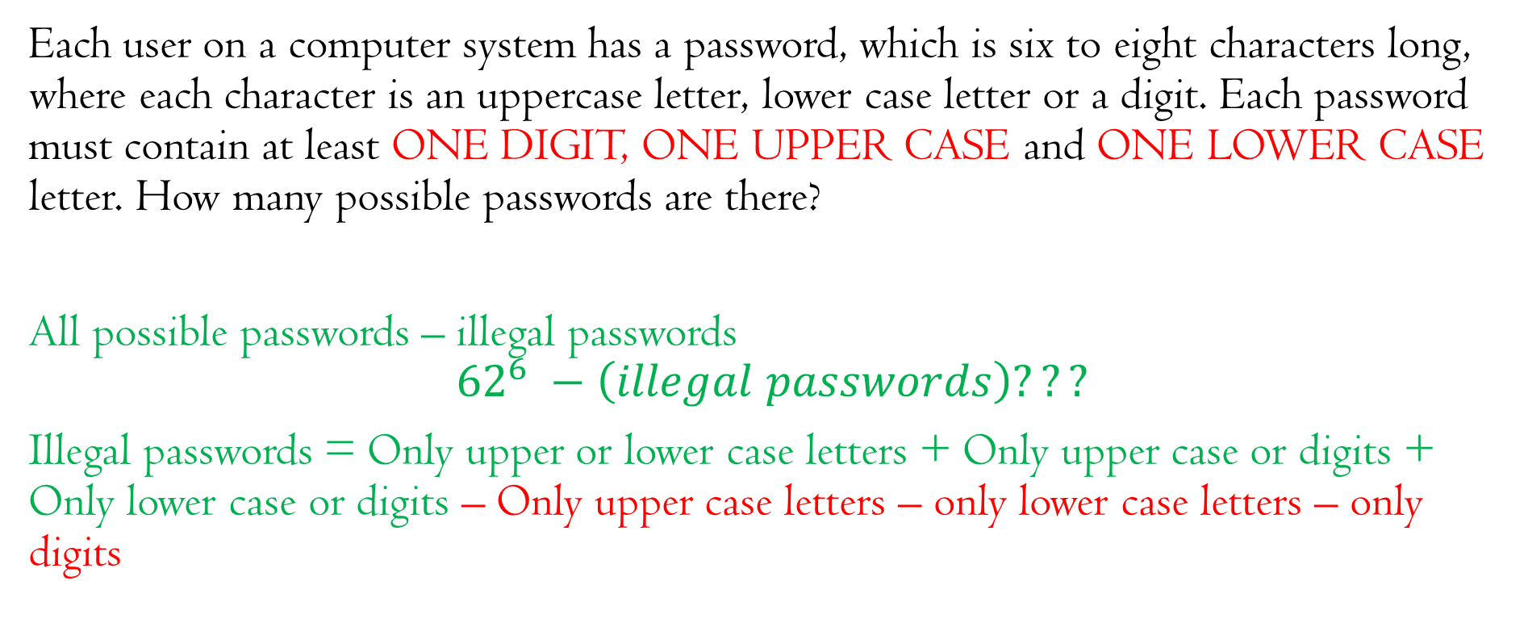
Problem 7: Counting Passwords again
Examples: PIE --- Do it by yourself
Each user on a computer system has a password, which is six to eight characters long, where each character is an uppercase letter, lower case letter or a digit. Each password must contain at least ONE DIGIT, ONE UPPER CASE and ONE LOWER CASE letter. How many possible passwords are there?
All possible passwords – illegal passwords
$${62}^{6} −\left(illegal passwords\right)???$$
Illegal passwords = Only upper or lower case letters + Only upper case or digits + Only lower case or digits – Only upper case letters – only lower case letters – only digits

Slide 22
Problem 7: Counting Passwords again
Examples: PIE --- Do it by yourself
Each user on a computer system has a password, which is six to eight characters long, where each character is an uppercase letter or a digit. Each password must contain at least ONE DIGIT, ONE UPPER CASE and ONE LOWER CASE letter. How many possible passwords are there?
Solution:
(All Passwords) – (Small and Capital ONLY) – (Small and Digits) – (Capital and Digits) ???

Slide 23
Problem 7: Counting Passwords again
Examples: PIE --- Do it by yourself
Each user on a computer system has a password, which is six to eight characters long, where each character is an uppercase letter or a digit. Each password must contain at least ONE DIGIT, ONE UPPER CASE and ONE LOWER CASE letter. How many possible passwords are there?
Solution:
(All Passwords) – (Small or Capital ONLY) – (Small or Digits) – (Capital or Digits) + (Small only) + (capital) + (Digits)

Slide 24


Slide 25
MORE PRACTICE PROBLEMS
Do it by yourself

Slide 26
Examples: PIE --- Do it by yourself
Finding a Formula for the Number of Elements in the Union of Three Sets.
Venn Diagram???

Slide 27
Extension of PIE
Finding a Formula for the Number of Elements in the Union of Three Sets.

Slide 28
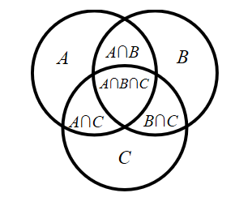
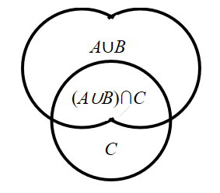

Slide 29
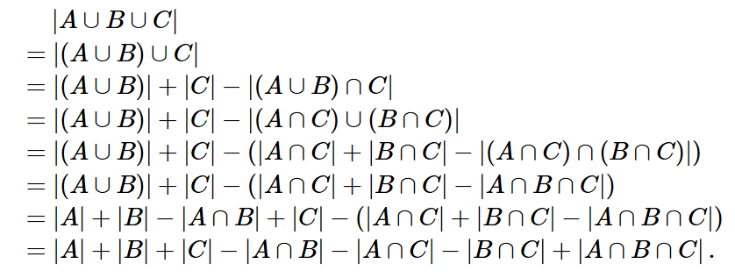

Slide 30
Problem: Application of PIE

Slide 32

Principle of Inclusion-Exclusion
Try it at your own:
In a survey on the college students, the following data was obtained:
• 78 like Vanilla Ice-cream
• 32 like Chocolate
• 57 like Mango Ice-cream
• 13 like both Vanilla Ice-cream and Chocolate
• 21 like both Chocolate and Mango Ice-cream
• 16 like both Mango Ice-cream and Vanilla Ice-cream
• 5 like all three ﬂavors above
• 14 like none of these three ﬂavors
How many students were surveyed?
(78 + 32 + 57 – 13 – 21 – 16 + 5) + 14 = Total Students

Slide 33
How many positive integers under 500 are not divisible by either of the numbers 2,3,5,11?
Try it at your own:

Slide 34
How many positive integers under 500 are not divisible by either of the numbers 2,3,5,11?
Try it at your own:
[To Begin:]We use the following formula: the number of positive integers strictly smaller than 500 and divisible by n is 499/n.
Now consider the following sets:
A : the set of positive integers strictly smaller than 500 (there are 499 such numbers);
A1 : the set of positive integers strictly smaller than 500 that are divisible by 2 (there are 249 such numbers);
A2 : the set of positive integers smaller than 500 that are divisible by 3 (there are 166 such numbers);
A3 : the set of positive integers smaller than 500 that are divisible by 5 (there are 99 such numbers);
A4 : the set of positive integers smaller than 500 that are divisible by 11 (there are 45 such numbers).
We are interested in the cardinality of the following set
|A\(A1 ∪A2 ∪A3 ∪A4)|.
Since A1, A2, A3 and A4 are all subsets of A, the value above is equal to
|A|−|A1 ∪A2 ∪A3 ∪A4|.

Slide 35
Self-assessment Quiz:
Try it at your own:
1. XinHua Chinese Cuisine oﬀers an early-bird dinner special, which includes one of four entrees, either a soup (two kinds) or a salad (four choices), and a dessert (three choices). In how many diﬀerent ways can one order all three courses from the special menu?
2. How many functions are there from a 5-element set A to a 6-element set B? How many are one-to-one?
3. How many subsets of {1,2,...,8} contain more than one element?
4. How many bit strings of length eight either start with 01 or end with 01?

Slide 36
Self-assessment Quiz:
Try it at your own:
XinHua Chinese Cuisine oﬀers an early bird dinner special, which includes one of four entrees, either a soup (two kinds) or a salad (four choices), and a dessert (three choices). In how many diﬀerent ways can one order all three courses from the special menu?
Solution: A hypothetical diner can order an entree in four ways, one of six ﬁrst courses, and one of three desserts. By the product rule, there are 4·6·3 = 72 ways to order.

Slide 37
Self-assessment Quiz:
Try it at your own:
2. How many functions are there from a 5-element set A to a 6-element set B? How many are one-to-one?
Solution: Let A = {a1,a2,...,a5}. In the ﬁrst case, there are 6 choices for the image of each element ai ∈ A, so by the product rule there are 6^5 = 7776 such functions.
If the function must be one-to-one, there are six choices for the image of a1, then ﬁve choices for the image of a2, etc. So there are 6·5·4·3·2 = 6! = 720 one-to-one functions from A to B

Slide 38
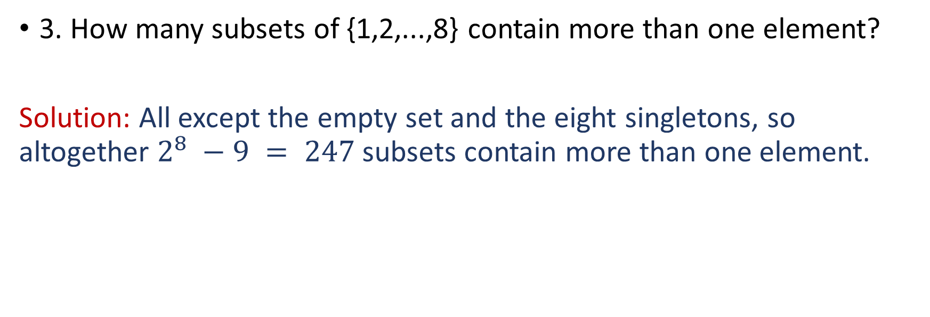
Self-assessment Quiz:
Try it at your own:
3. How many subsets of {1,2,...,8} contain more than one element?
Solution: All except the empty set and the eight singletons, so altogether $2^{8} −9 = 247$subsets contain more than one element.

Slide 39
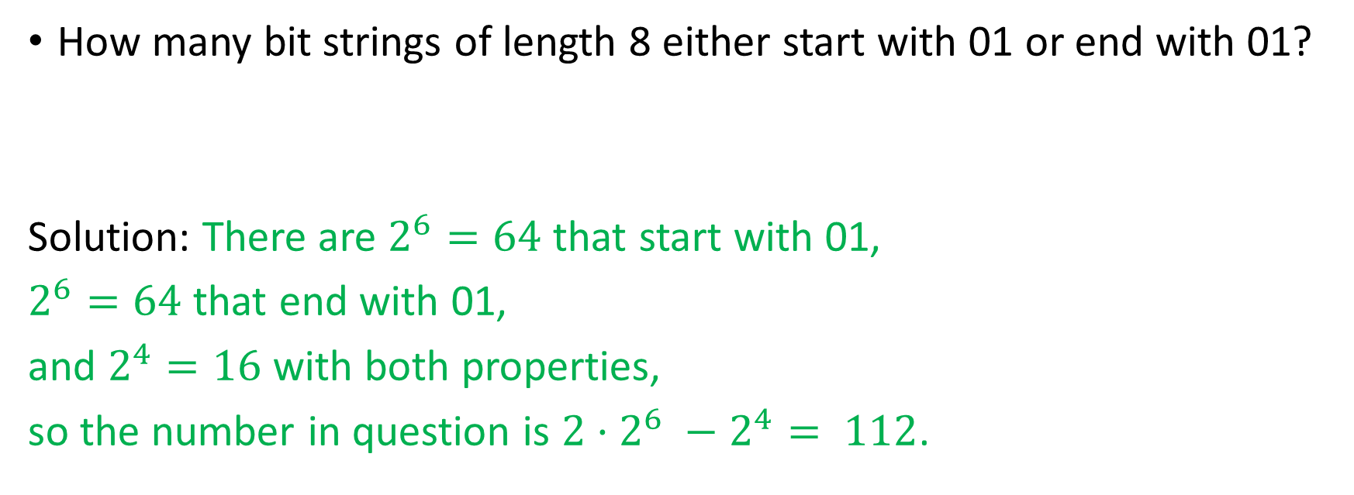
Self-assessment Quiz:
Try it at your own:
How many bit strings of length 8 either start with 01 or end with 01?
Solution: There are $2^{6}=64$ that start with 01,
$2^{6}=64$ that end with 01,
and $2^{4}=16$ with both properties,
so the number in question is $2·2^{6} −2^{4}= 112$.

Slide 40
Exercise: Inclusion Exclusion Principle:
Try it at your own:
In a mathematics contest with three problems, 80% of the participants solved the ﬁrst problem, 75% solved the second and 70% solved the third. Prove that at least 25% of the participants solved all three problems.

Slide 41
Exercise: Inclusion Exclusion Principle:
Try it at your own:
In a mathematics contest with three problems, 80% of the participants solved the ﬁrst problem, 75% solved the second and 70% solved the third. Prove that at least 25% of the participants solved all three problems.
====================================================
Solution: Let the total number of participants be n > 0 (if n = 0, the proof is trivial).
Denote the set of people who missed the ﬁrst problem by A, the set of people who missed the second by B, and the set who missed the third by C.
We know that |A| = n −0.8n = 0.2n, |B| = n −0.75n = 0.25n and |C|= n−0.7n = 0.3n.
We also know, that |A∪B∪C|≤|A|+|B|+|C|= 0.2n +0.25n +0.3n = 0.75n
The set of people who solved all three problems is the complement of A∪B ∪C (the set who missed at least one problem), so it has size
n−|A∪B∪C|≥ n−0.75n = 0.25n
Therefore at least 25% of the participants solved all three problems.

Slide 42
Count the number of bit-strings of length 8 with 3 consecutive zeros or 4 consecutive ones.
Try it at your own:
Number of strings with 3 consecutive zeros = 25+5×24=11225+5×24=112 , because the 3 zeros can start at bit number 1, 2, 3, .., 6
Number of strings with 4 consecutive ones = 24+4×23=4824+4×23=48 , I used the same reasoning.
Now I am trying to count the number of bit-strings that contain both 3 consecutive zeros and 4 consecutive 1s. I reasoned as follows:
the strings can be of the following forms: 0001111x, 000x1111, x0001111.. thus there are 2+2+2=62+2+2=6 possibilities for bit-strings where the 3 consecutive zeros come first.
Symmetrically there are 66 bit-strings where the 4 consecutive ones come first.
Thus the answer should be = 112+48−12=148112+48−12=148 .
So 00010000, 00010001, 00001000, 00011000, 10001000, 00010000, 00010001, 00001000, 00011000, 10001000 were added to your total twice.
This didn't cause any problems in your count of strings with four 11 s, however, since we can't put four 11 s in two separated places in an 88 -bit string.
So the union now has155 elements, and cutting out the two duplicates from each symmetry of your intersection calculation turns that to 88 ,
for a total 107+48−8=147107+48−8=147

Slide 43
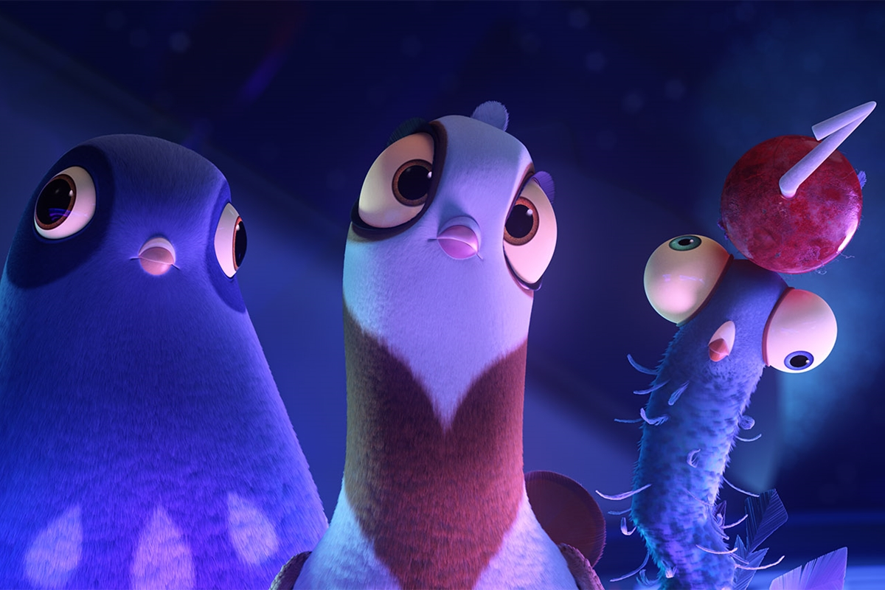
Pigeonhole Principle
Maryiam Zahoor
Email: maryiam.zahoor@ucp.edu.pk
My office:
Room#104, C block, behind Gym

Slide 44
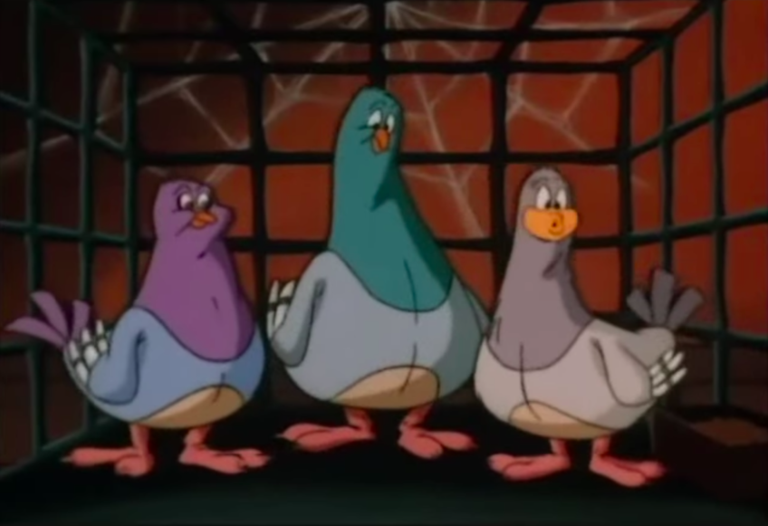
Pigeonhole Principle PHP

Slide 45
We come across problems like these? (We shall find the solution at the end of the lecture)
If you pick 5 integers from 1 to 8, you will definitely find two of them must add up to 9.
There are n people in a party and n is more than 1 so they can shake hands with one another at will.
You will always find two people who shake hands with the same number of people.
Choose 51 numbers from integers between 1 and 100 inclusively. Then there must be two consecutive numbers of among the chosen integers.

Slide 46
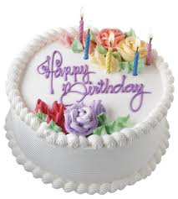
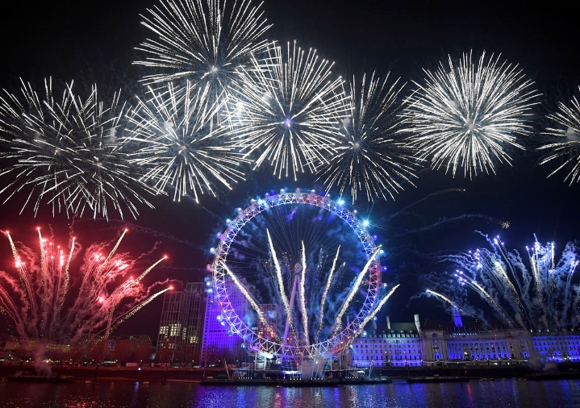
Two or more people in UCP have the same birthday
Let us try to solve the simpler ones? You have one minute to answer

Slide 47
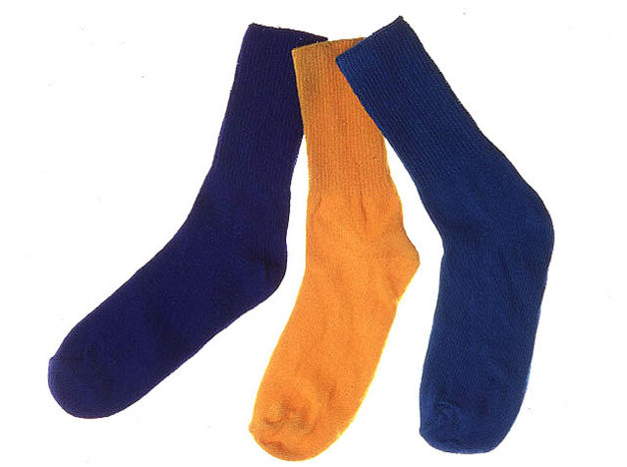
A Pair of Socks
Let us try to solve the simpler ones? You have one minute to answer
Assume you have 10 orange socks and 10 blue socks
and you want to find a matching pair of socks from a
Random pick. How many socks you will need to pick?
You will only need to pick three socks

Slide 48
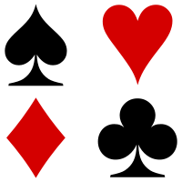
A Suit of Cards
Let us try to solve the simpler ones? You have one minute to answer
From a standard deck of 52 cards, how many cards you need to pick to guarantee at least two cards will be of the same suit.
Pick 5 cards

Slide 49
Hair: Two or more people in Lahore have the same number of hair on their heads
Let us try to solve the simpler ones? You have one minute to answer
At any given time in Lahore City there live at least two people who have the same amount of hairs on their head

Slide 50
Hair: Two or more people in Lahore have the same number of hair on their heads
Let us try to solve the simpler ones? You have one minute to answer
At any given time in Lahore there live at least two people who have the same amount of hairs on their head
A human has a maximum of about 500,000 hairs. In comparison, there are millions of people in a metropolitan, which outnumbers the number of hairs a human normally has. By pigeonhole principle, at least two of them must have the same number of hairs

Slide 51
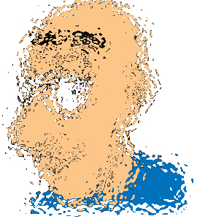
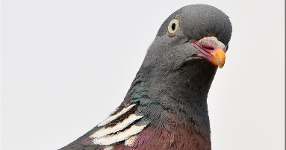
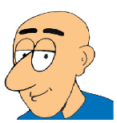
Pigeonhole Principle---
(Section 2.4 of textbook)
LET US FORMULATE THE PROBLEM NOW
If there were no two people with the same number of strands of hair, then,
there would be at most one person having 0 strands,

Slide 52
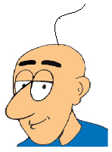
Pigeonhole Principle---
(Section 2.4 of textbook)
LET US FORMULATE THE PROBLEM NOW
If there were no two people with the same number of strands of hair, then,
there would be at most one person having 0 strands,
at most one person having exactly 1 strand,

Slide 53
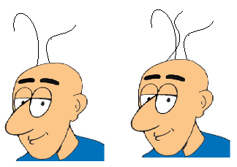
Pigeonhole Principle---
(Section 2.4 of textbook)
LET US FORMULATE THE PROBLEM NOW
If there were no two people with the same number of strands of hair, then,
there would be at most one person having 0 strands,
at most one person having exactly 1 strand,
and so on.

Slide 54
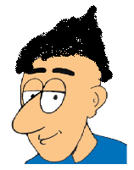
Pigeonhole Principle---
(Section 2.4 of textbook)
LET US FORMULATE THE PROBLEM NOW
If there were no two people with the same number of strands of hair, then,
there would be at most one person having 0 strands,
at most one person having exactly 1 strand,
and so on.
Finally, there would be at most one person having exactly 500,000 strands.

Slide 55
Pigeonhole Principle---
(Section 2.4 of textbook)
LET US FORMULATE THE PROBLEM NOW
If there were no two people with the same number of strands of hair, then,
there would be at most one person having 0 strands,
at most one person having exactly 1 strand,
and so on.
Finally, there would be at most one person having exactly 500,000 strands.
But then this means that there are no more than 500,001 inhabitants of Lahore.

Slide 56
Pigeonhole Principle---
(Section 2.4 of textbook)
Imagine 500,001 enormous boxes (or pigeon holes)

Slide 57
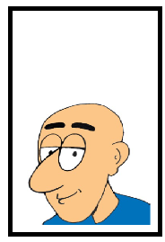
Pigeonhole Principle---
(Section 2.4 of textbook)
Imagine 500,001 enormous boxes (or pigeon holes)
The first one is labeled “Lahoris having 0 strands of hair,”

Slide 58
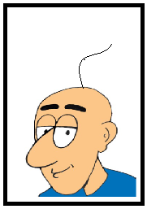
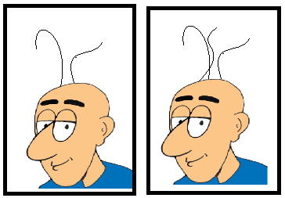
Pigeonhole Principle---
(Section 2.4 of textbook)
Imagine 500,001 enormous boxes (or pigeon holes)
The first one is labeled “Lahoris having 0 strands of hair,”
the next is labeled “Lahoris having 1 strand of hair,”
and so on.

Slide 59
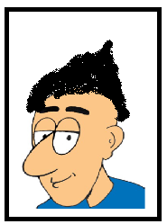
Pigeonhole Principle---
(Section 2.4 of textbook)
Imagine 500,001 enormous boxes (or pigeon holes)
The first one is labeled “Lahoris having 0 strands of hair,”
the next is labeled “Lahoris having 1 strand of hair,”
and so on.
The last box is labeled “Lahoris having 500,000 strands of hair”

Slide 60
Pigeonhole Principle---
(Section 2.4 of textbook)
Imagine 500,001 enormous boxes (or pigeon holes)
The first one is labeled “Lahoris having 0 strands of hair,”
the next is labeled “Lahoris having 1 strand of hair,”
and so on.
The last box is labeled “Lahoris having 500,000 strands of hair”
If everybody goes to the proper box, then about 10 million Lahoris are properly assigned to some box (or hole).
Since we have only 500,001 boxes, there certainly will be a box containing more than one Lahori.

Slide 61
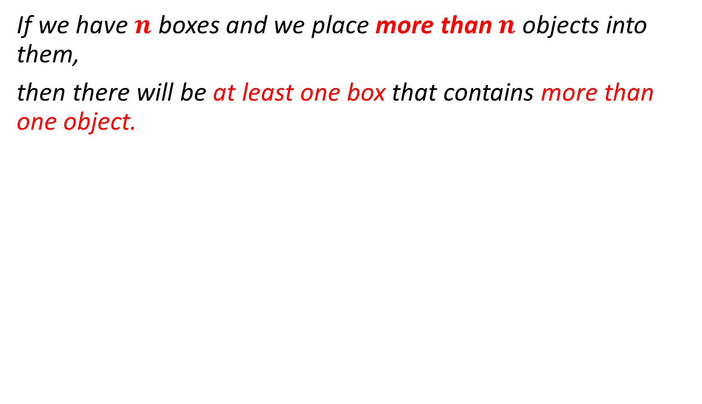
Pigeonhole Principle---
(Section 2.4 of textbook)
If we have $n$ boxes and we place more than $n$ objects into them,
then there will be at least one box that contains more than one object.

Slide 62
Pigeonhole Principle---

Slide 63
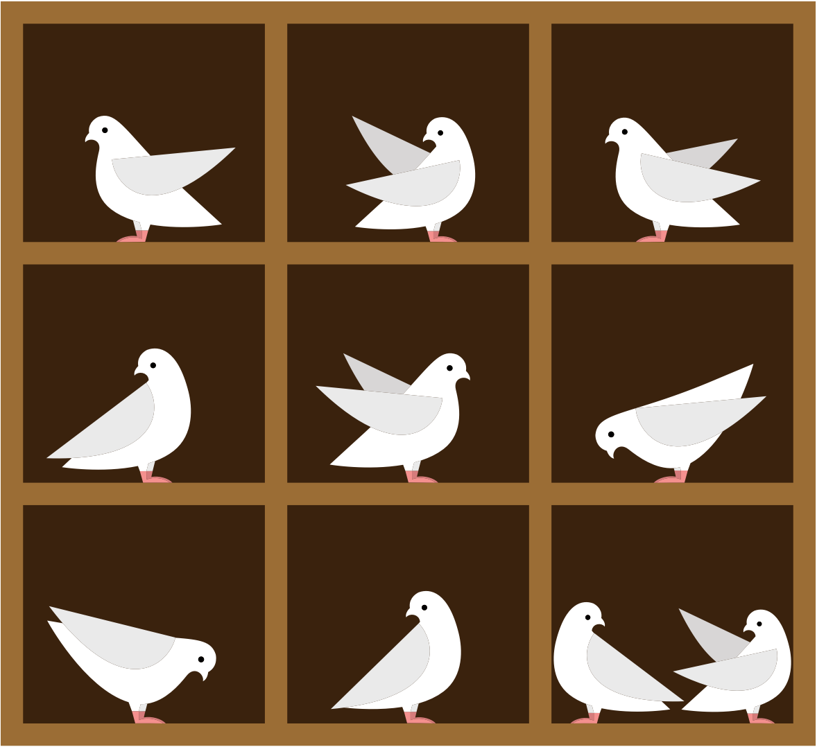
Pigeonhole Principle---

Slide 64
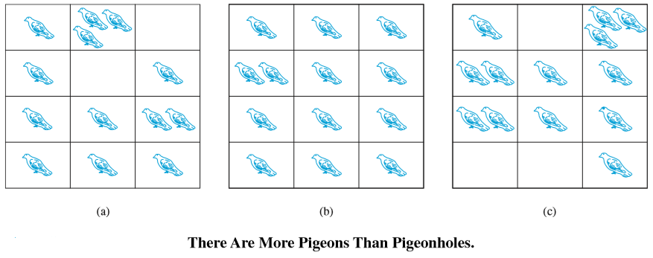
Pigeonhole Principle---

Slide 65
Figure out what are the pigeons and what are the pigeon-holes !!!
Pigeonhole Principle---

Slide 66
Examples: PHP --- Do it by yourself
EXAMPLE 1
Among any group of 367 people, there must be at least two with the same birthday, because there are only 366 possible birthdays.

Slide 67
Examples: PHP --- Do it by yourself
EXAMPLE 2
In any group of 27 English words, how many minimum words will begin with same letter?
There must be at least two that begin with the same letter, because there are 26 letters in the English alphabet.

Slide 68
Examples: PHP --- Do it by yourself
EXAMPLE 3
How many students must be in a class to guarantee that at least two students receive the same score on the ﬁnal exam, if the exam is graded on a scale from 0 to 100 points?
Solution:

Slide 69
Examples: PHP --- Do it by yourself
EXAMPLE 3
How many students must be in a class to guarantee that at least two students receive the same score on the ﬁnal exam, if the exam is graded on a scale from 0 to 100 points?
Solution:
There are 101 possible scores on the ﬁnal. The pigeon-hole principle shows that among any 102 students there must be at least 2 students with the same score.
How many students to guarantee that at least 3 should receive the same score?

Slide 70
Examples: PHP --- Do it by yourself
EXAMPLE 4
How many students must be in a class to guarantee that at least 5 students receive the same score on the ﬁnal exam, if the exam is graded on a scale from 0 to 100 points?
4*101 + 1 = 405

Slide 71
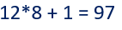
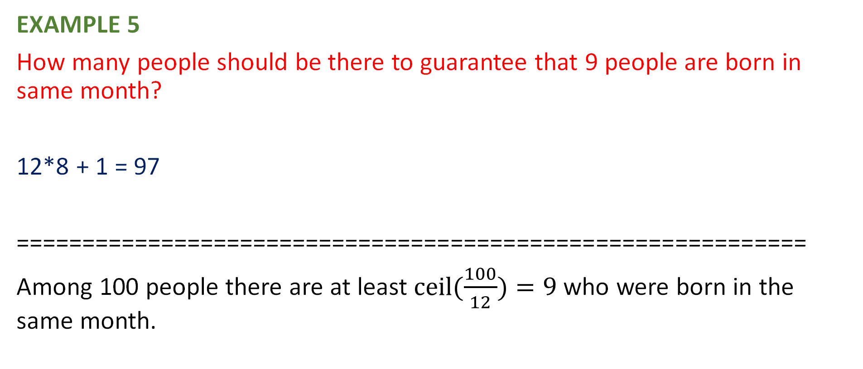
Examples: PHP --- Do it by yourself
EXAMPLE 5
How many people should be there to guarantee that 9 people are born in same month?
12*8 + 1 = 97
============================================================
Among 100 people there are at least $ceil(\frac{100}{12})=9$ who were born in the same month.

Slide 72
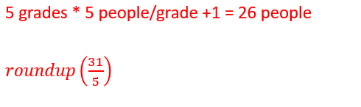
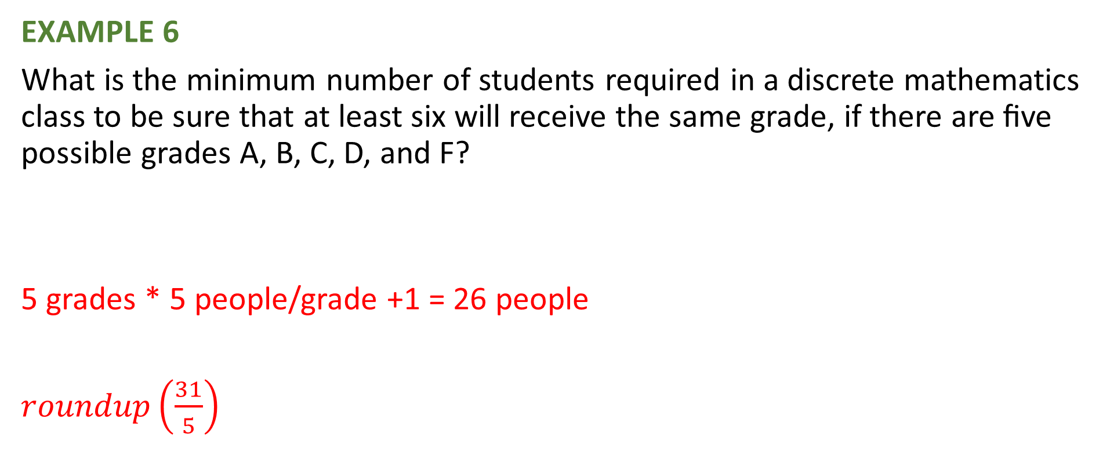
Examples: PHP --- Do it by yourself
EXAMPLE 6
What is the minimum number of students required in a discrete mathematics class to be sure that at least six will receive the same grade, if there are ﬁve possible grades A, B, C, D, and F?
5 grades * 5 people/grade +1 = 26 people
$roundup\left(\frac{31}{5}\right)$

Slide 73
Examples: PHP --- Do it by yourself
EXAMPLE 7
a) How many cards must be selected from a standard deck of 52 cards to guarantee that at least three cards of the same suit are chosen?
b) How many must be selected to guarantee that at least three hearts are selected?

Slide 74
Examples: PHP --- Do it by yourself
How many students do you need in a school to guarantee that there are atleast two students who have the same first two initials?
Objects= Students?
Boxes= total possibilities of 2 initials.
Boxes= 26*26
Hence objects= (26^2)+1

Slide 75
Examples: PHP --- Do it by yourself
Given any 5 points inside a square of side length 2, there is always a pair whose distance apart is at most √2

Slide 76
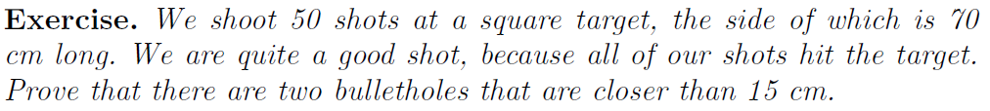
Example
Examples: PHP --- Do it by yourself
From the textbook (Section 2.4 – Pages 35-36)

Slide 77
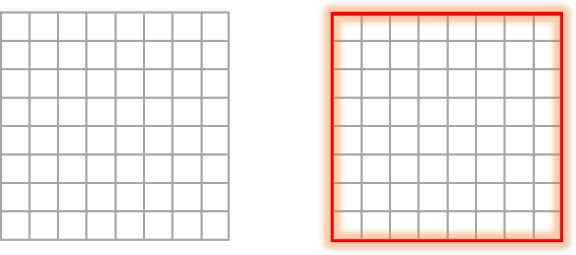
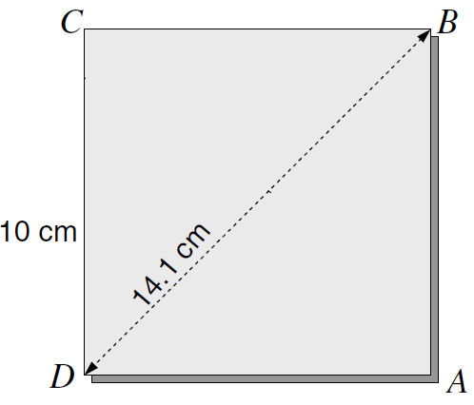
Example
Examples: PHP --- Do it by yourself
From the textbook (Section 2.4 – Pages 35-36)

Slide 78
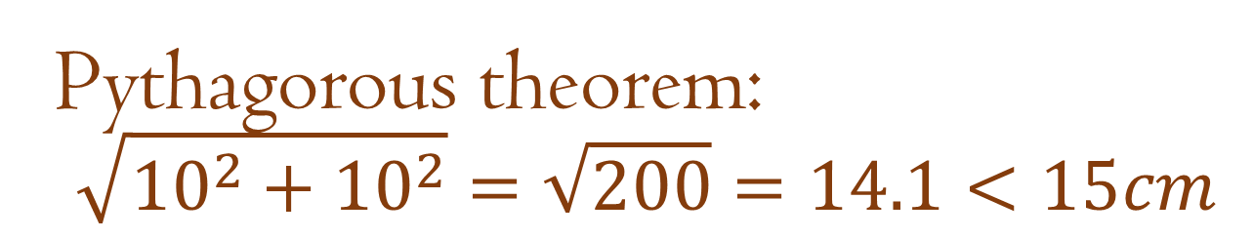
Pythagorous theorem: $$\sqrt{{10}^{2}+{10}^{2}}=\sqrt{200}=14.1<15cm$$
Examples: PHP --- Do it by yourself
Example
From the textbook (Section 2.4 – Pages 35-36)

Slide 79
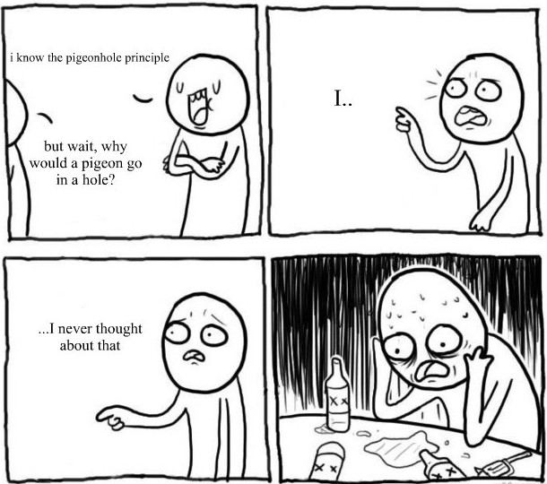

Slide 80
MORE PRACTICE PROBLEMS
Do it by yourself

Slide 81
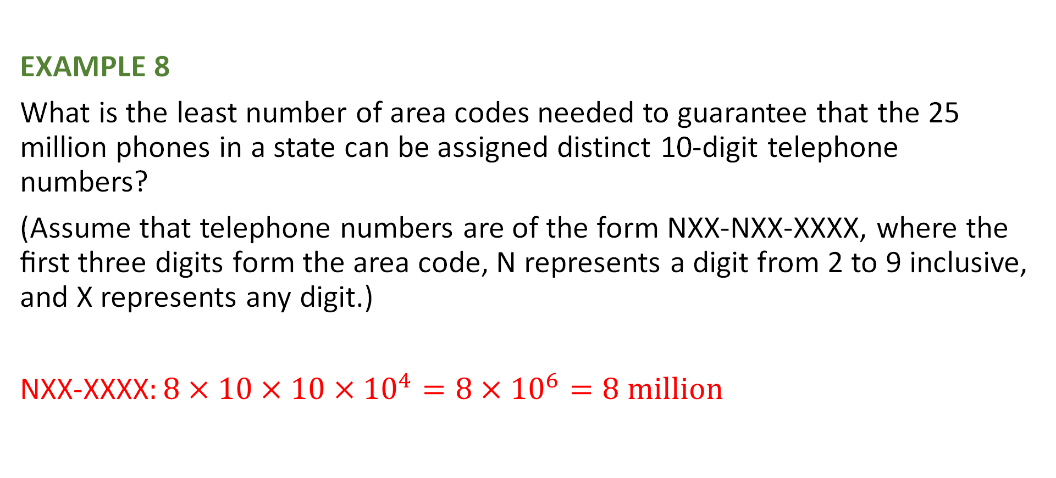
Try to solve this one?
EXAMPLE 8
What is the least number of area codes needed to guarantee that the 25 million phones in a state can be assigned distinct 10-digit telephone numbers?
(Assume that telephone numbers are of the form NXX-NXX-XXXX, where the ﬁrst three digits form the area code, N represents a digit from 2 to 9 inclusive, and X represents any digit.)
NXX-XXXX$:8×10×10×{10}^{4}=8×{10}^{6}=8 million$
Ceil (25,000,000 / 8,000,000 )= 4

Slide 82
Examples: PHP --- Do it by yourself

Slide 83
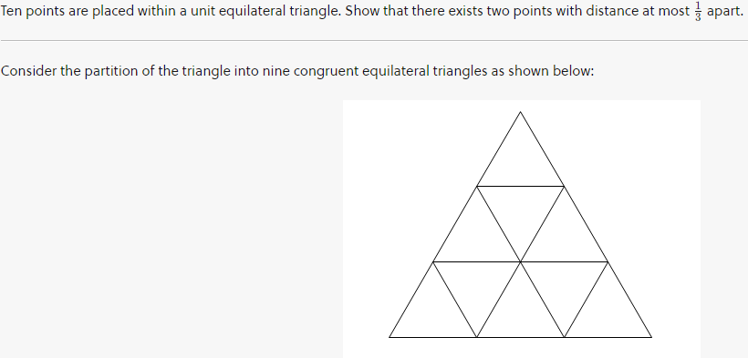
Examples: PHP --- Do it by yourself

Slide 84
Examples: PHP --- Do it by yourself

Slide 85
Pigeonhole Principle
Try it at your own:
If you pick 5 integers from 1 to 8, you will definitely find two of them must add up to 9.
1,8
2,7
3,6
4,5

Slide 86
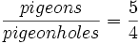
Pigeonhole Principle
Try it at your own:
If you pick 5 integers from 1 to 8, you will definitely find two of them must add up to 9.
No matter which integer you choose, you can always pair it with another integer from 1 to 8 to sum to 9.
Thus, there are four such pairs overall:
We are going to stuff five pigeons (chosen integers) into four pigeonholes (pairs).
By the pigeonhole principle, the average value = ,
so the maximum value is at least 2.
Two of the integers must be from the same pair, which sums to 9.

Slide 87

Shaking Hands
Try it at your own:
Pigeonhole Principle
There are n people in a party and n is more than 1 so they can shake hands with one another at will.
You will always find two people who shake hands with the same number of people.

Slide 88
Do I Know You?
Try it at your own:
Pigeonhole Principle
In a room with n people in it, there must be at least two people who are friends with the same number of people.

Slide 89
Binomial Coefficient
Maryiam Zahoor
Email: Maryiam.Zahoor@ucp.edu.pk
Office :
104, C block, behind gym
Office hours:
Monday 9:30- 11:00
Tuesday 11:00 - 12:30
Thursday 3:30 – 4:30
Friday 9:30 - 11:00

Slide 90
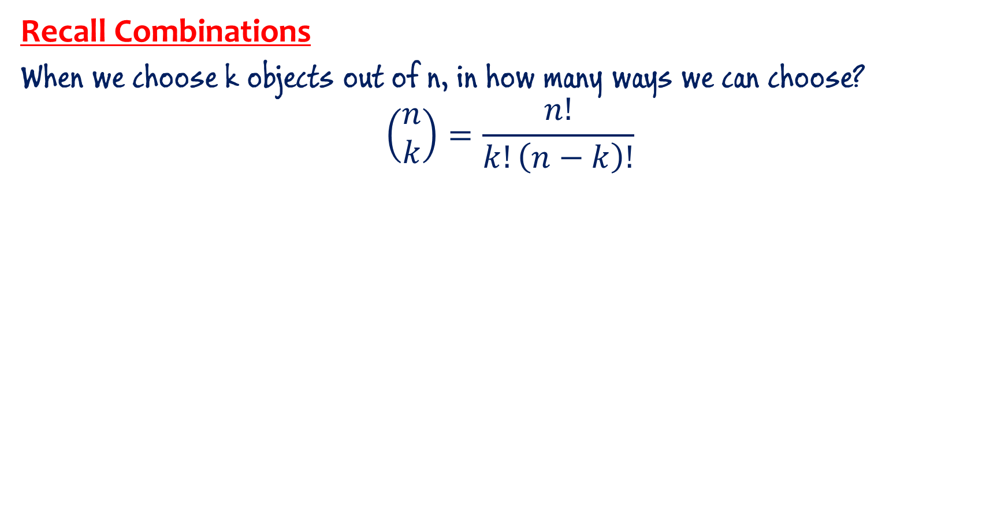
Recap
Recall Combinations
When we choose k objects out of n, in how many ways we can choose?
$$\left(\begin{aligned}n \\ k\end{aligned}\right)=\frac{n!}{k!\left(n−k\right)!}$$

Slide 91
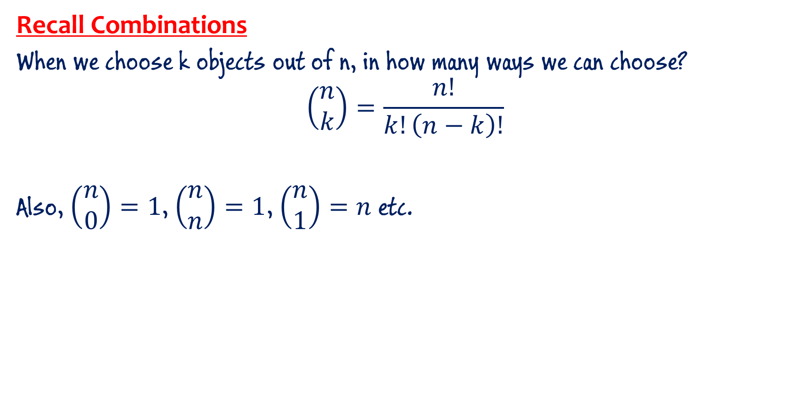
Recap
Recall Combinations
When we choose k objects out of n, in how many ways we can choose?
$$\left(\begin{aligned}n \\ k\end{aligned}\right)=\frac{n!}{k!\left(n−k\right)!}$$
Also, $\left(\begin{aligned}n \\ 0\end{aligned}\right)=1$, $\left(\begin{aligned}n \\ n\end{aligned}\right)=1$, $\left(\begin{aligned}n \\ 1\end{aligned}\right)=n$ etc.

Slide 92
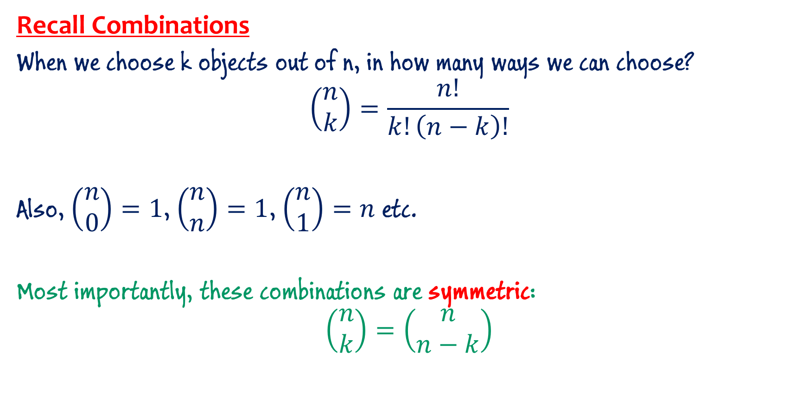
Recap
Recall Combinations
When we choose k objects out of n, in how many ways we can choose?
$$\left(\begin{aligned}n \\ k\end{aligned}\right)=\frac{n!}{k!\left(n−k\right)!}$$
Also, $\left(\begin{aligned}n \\ 0\end{aligned}\right)=1$, $\left(\begin{aligned}n \\ n\end{aligned}\right)=1$, $\left(\begin{aligned}n \\ 1\end{aligned}\right)=n$ etc.
Most importantly, these combinations are symmetric:
$$\left(\begin{aligned}n \\ k\end{aligned}\right)=\left(\begin{aligned}n \\ n−k\end{aligned}\right)$$

Slide 93
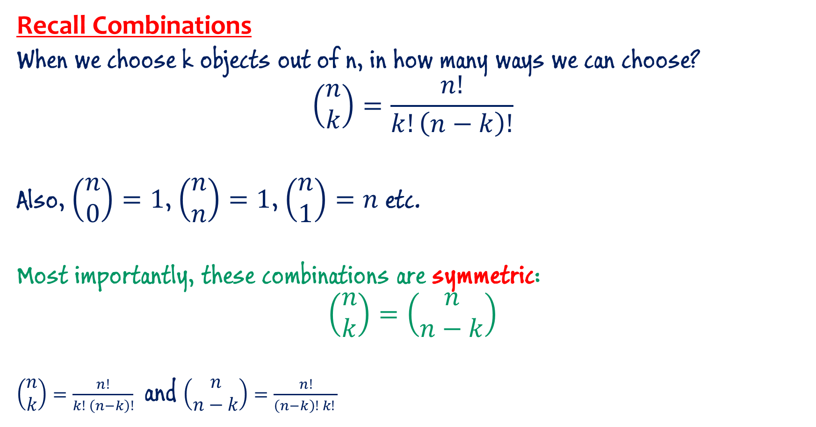
Recap
Recall Combinations
When we choose k objects out of n, in how many ways we can choose?
$$\left(\begin{aligned}n \\ k\end{aligned}\right)=\frac{n!}{k!\left(n−k\right)!}$$
Also, $\left(\begin{aligned}n \\ 0\end{aligned}\right)=1$, $\left(\begin{aligned}n \\ n\end{aligned}\right)=1$, $\left(\begin{aligned}n \\ 1\end{aligned}\right)=n$ etc.
Most importantly, these combinations are symmetric:
$$\left(\begin{aligned}n \\ k\end{aligned}\right)=\left(\begin{aligned}n \\ n−k\end{aligned}\right)$$
$\left(\begin{aligned}n \\ k\end{aligned}\right)=\frac{n!}{k! \left(n−k\right)!}$ and $\left(\begin{aligned}n \\ n−k\end{aligned}\right)=\frac{n!}{\left(n−k\right)! k! }$

Slide 94


Binomial Theorem ${\left(x+y\right)}^{n}$

Slide 95

Binomial Theorem (Some familiar expressions)
${\left(x+y\right)}^{2}= ???$

Slide 96

Binomial Theorem (Some familiar expressions)
${\left(x+y\right)}^{2}= ???$
$${\left(x+y\right)}^{2}=x^{2}+y^{2}+2xy$$
or
$${\left(x+y\right)}^{2}=x^{2}+2xy+y^{2}$$

Slide 97

Binomial Theorem (Some familiar expressions)
${\left(x+y\right)}^{2}= ???$
$${\left(x+y\right)}^{2}=x^{2}+y^{2}+2xy$$
or
$${\left(x+y\right)}^{2}=x^{2}+2xy+y^{2}$$
I shall opt for the second notation … it is same thing but a different way, an organized way, to express.

Slide 98

Binomial Theorem (Some familiar expressions)
${\left(x+y\right)}^{2}=x^{2}+2xy+y^{2}$
${\left(x+y\right)}^{3}=???$

Slide 99

Binomial Theorem (Some familiar expressions)
${\left(x+y\right)}^{2}=x^{2}+2xy+y^{2}$
$${\left(x+y\right)}^{3}=\left(x+y\right)⋅{\left(x+y\right)}^{2}=\left(x+y\right)⋅\left(x^{2}+2xy+y^{2}\right)$$
$$=x^{3}+3x^{2}y+3xy^{2}+y^{3}$$

Slide 100

Binomial Theorem (Some familiar expressions)
${\left(x+y\right)}^{2}=x^{2}+2xy+y^{2}$
${\left(x+y\right)}^{3}=x^{3}+3x^{2}y+3xy^{2}+y^{3}$
${\left(x+y\right)}^{4}={\left(x+y\right)⋅{\left(x+y\right)}^{3}=\left(x+y\right)⋅(x}^{3}+3x^{2}y+3xy^{2}+y^{3})$
$$=x^{4}+4x^{3}y+6x^{2}y^{2}+4xy^{3}+y^{4}$$

Slide 101

Binomial Theorem (Some familiar expressions)
${\left(x+y\right)}^{2}=x^{2}+2xy+y^{2}$
${\left(x+y\right)}^{3}=x^{3}+3x^{2}y+3xy^{2}+y^{3}$
${\left(x+y\right)}^{4}=x^{4}+4x^{3}y+6x^{2}y^{2}+4xy^{3}+y^{4}$
and so on …
$${\left(x+y\right)}^{5}=\left(x+y\right)⋅\left(x+y\right)⋅\left(x+y\right)⋅\left(x+y\right)⋅\left(x+y\right)$$
How do we multiply? To get rid of all parenthesis …

Slide 102

Binomial Theorem (Some familiar expressions)
${\left(x+y\right)}^{2}=x^{2}+2xy+y^{2}$
${\left(x+y\right)}^{3}=x^{3}+3x^{2}y+3xy^{2}+y^{3}$
${\left(x+y\right)}^{4}=x^{4}+4x^{3}y+6x^{2}y^{2}+4xy^{3}+y^{4}$
and so on …
$${\left(x+y\right)}^{5}=\left(x+y\right)⋅\left(x+y\right)⋅\left(x+y\right)⋅\left(x+y\right)⋅\left(x+y\right)$$
We get each of the term in expansion, by selecting one of the two terms in each factor, and multiplying them.
1st Factor
2nd Factor
3rd Factor
4th Factor
5th Factor

Slide 103

Binomial Theorem (Some familiar expressions)
$${\left(x+y\right)}^{5}=\left(x+y\right)⋅\left(x+y\right)⋅\left(x+y\right)⋅\left(x+y\right)⋅\left(x+y\right)$$
If we choose $x$ 2 times, then we must choose $y$3 times, and so we get $x^{2}y^{3}$.
1st Factor
2nd Factor
3rd Factor
4th Factor
5th Factor

Slide 104

Binomial Theorem (Some familiar expressions)
$${\left(x+y\right)}^{5}=\left(x+y\right)⋅\left(x+y\right)⋅\left(x+y\right)⋅\left(x+y\right)⋅\left(x+y\right)$$
If we choose $x$ 2 times, then we must choose $y$3 times, and so we get $x^{2}y^{3}$.
How many times do I get this same term, $x^{2}y^{3}$?
Number of ways to select 3 factors which supply $y$ … $\left(\begin{aligned}5 \\ 3\end{aligned}\right)$
Remaining 2 factors will supply $x$.
1st Factor
2nd Factor
3rd Factor
4th Factor
5th Factor

Slide 105

Binomial Theorem (Some familiar expressions)
$${\left(x+y\right)}^{5}=\left(x+y\right)⋅\left(x+y\right)⋅\left(x+y\right)⋅\left(x+y\right)⋅\left(x+y\right)$$
If we choose $x$ 2 times, then we must choose $y$3 times, and so we get $x^{2}y^{3}$.
How many times do I get this same term, $x^{2}y^{3}$?
Number of ways to select 3 factors which supply $y$ … $\left(\begin{aligned}5 \\ 3\end{aligned}\right)$
Or it is same as the number of ways to select 2 factors that supply $x$ … $\left(\begin{aligned}5 \\ 2\end{aligned}\right)$
Remaining 3 factors will supply $y$.
1st Factor
2nd Factor
3rd Factor
4th Factor
5th Factor

Slide 106

Binomial Theorem (Some familiar expressions)
$${\left(x+y\right)}^{5}=\left(x+y\right)⋅\left(x+y\right)⋅\left(x+y\right)⋅\left(x+y\right)⋅\left(x+y\right)$$
$${\left(x+y\right)}^{5}=\left(\begin{aligned}5 \\ 0\end{aligned}\right)x^{5}+\left(\begin{aligned}5 \\ 1\end{aligned}\right)x^{4}y+\left(\begin{aligned}5 \\ 2\end{aligned}\right)x^{3}y^{2}+\left(\begin{aligned}5 \\ 3\end{aligned}\right)x^{2}y^{3}+\left(\begin{aligned}5 \\ 4\end{aligned}\right)xy^{4}+\left(\begin{aligned}5 \\ 5\end{aligned}\right)y^{5}$$
$${\left(x+y\right)}^{5}=x^{5}+5 x^{4}y+10 x^{3}y^{2}+10 x^{2}y^{3}+5 xy^{4}+y^{5}$$
1st Factor
2nd Factor
3rd Factor
4th Factor
5th Factor

Slide 107


Binomial Theorem
or
${\left(x+y\right)}^{n}=\sum_{k=0}^{n}{\left(\begin{aligned}n \\ k\end{aligned}\right)}x^{n−k}y^{k}$

Slide 108

Examples: --- Do it by yourself
$\left(\begin{aligned}25 \\ 13\end{aligned}\right)$ or $\left(\begin{aligned}25 \\ 12\end{aligned}\right)$ : both are the same value

Slide 109

Examples: --- Do it by yourself
The term is: $\left(\begin{aligned}25 \\ 13\end{aligned}\right){(2x)}^{12}{\left(−3y\right)}^{13}=\left(\begin{aligned}25 \\ 13\end{aligned}\right)2^{12}{\left(−3\right)}^{13}x^{12}y^{13}$
Coefficient: $\left(\begin{aligned}25 \\ 13\end{aligned}\right)2^{12}{\left(−3\right)}^{13}$

